Slide 1
Europe’s environment 2025
Knowledge for resilience, prosperity and sustainability
Leena Ylä-Mononen, EEA Executive Director, 30 September 2025

Slide 2

© Source

Slide 3

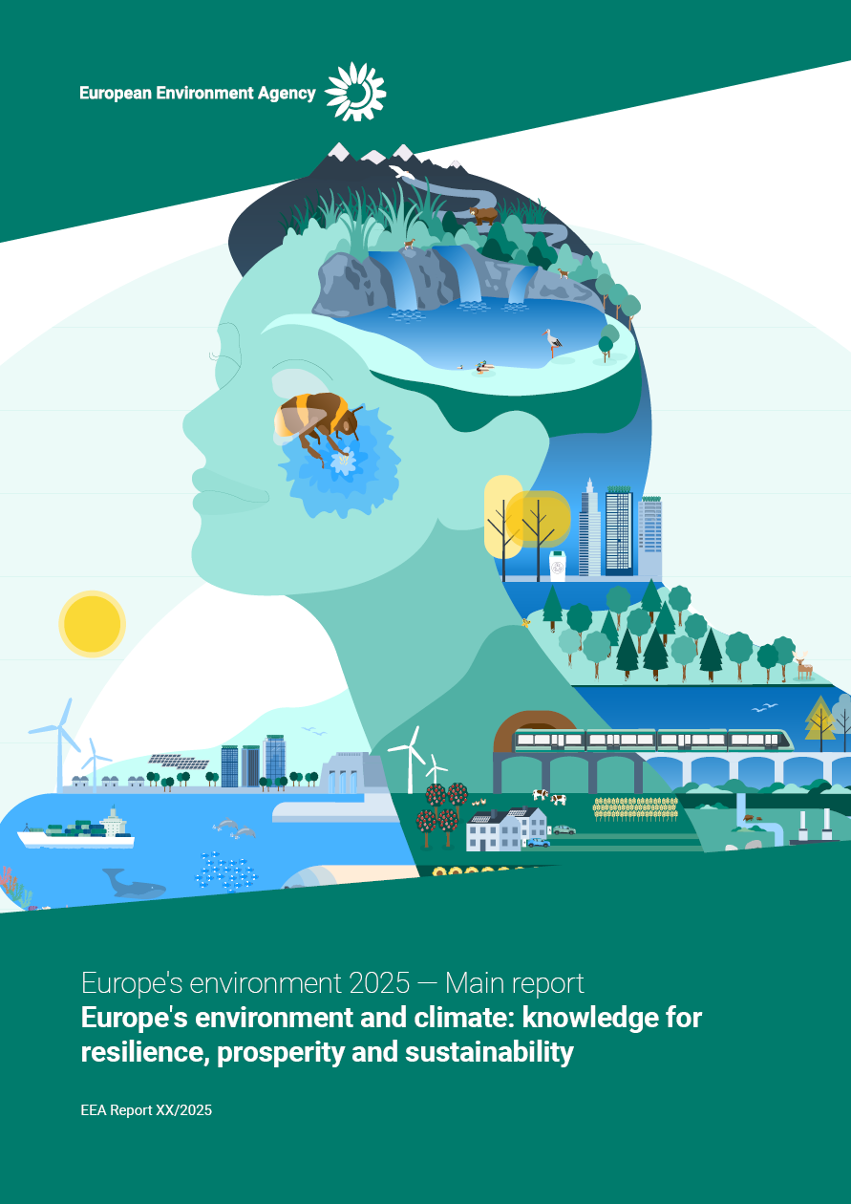
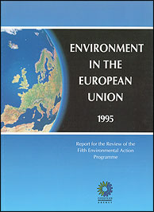
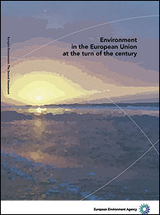
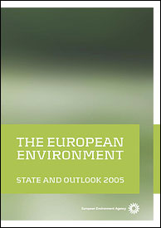

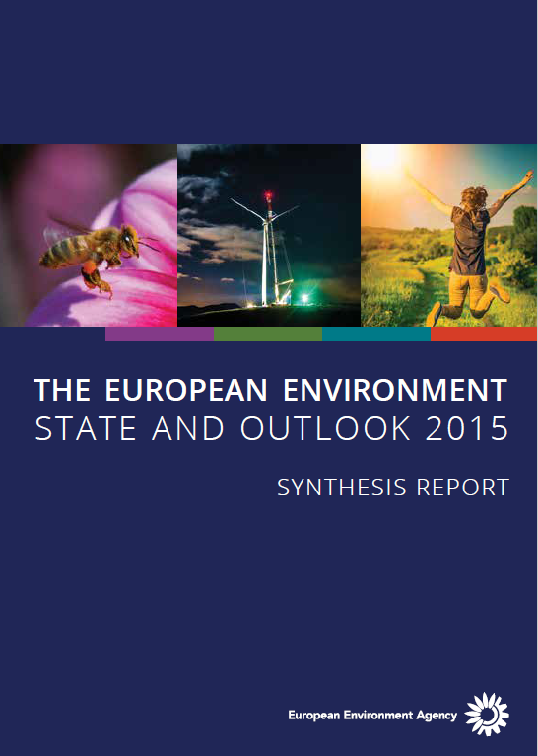
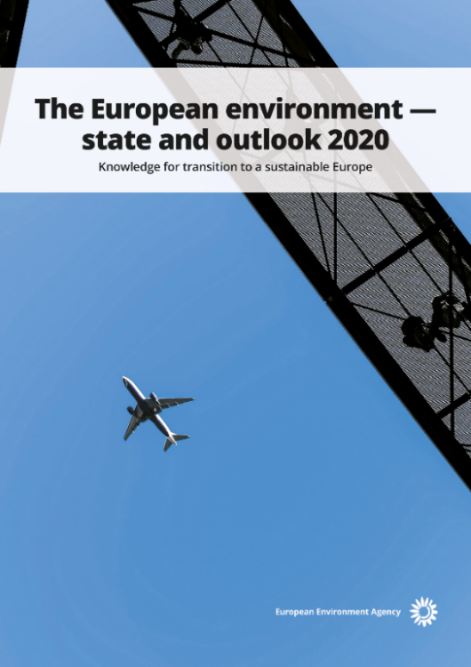
30 years state of environment reporting
2025
1995
2000
2005
2010
2015
2020

Slide 4
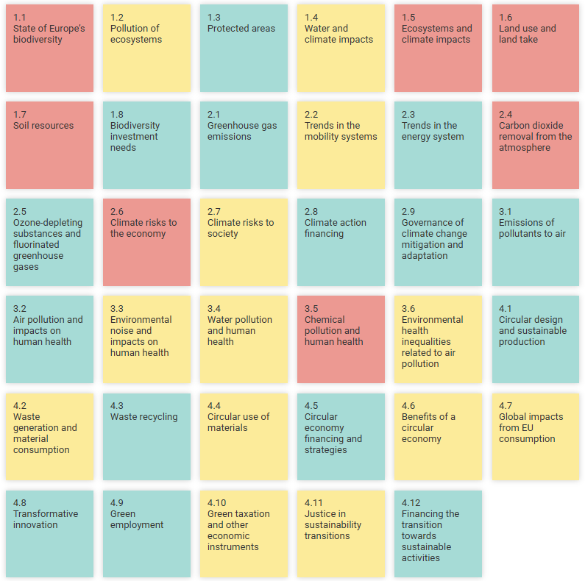
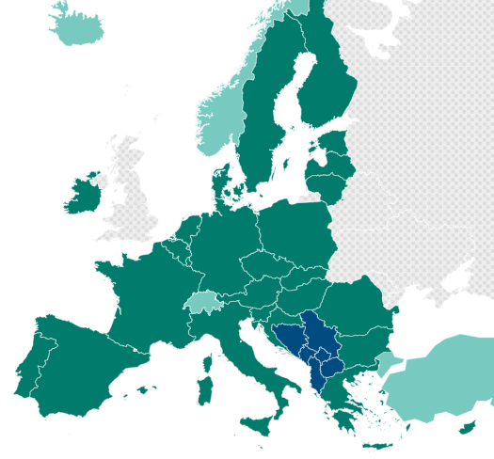
Europe’s environment 2025
1.
2.
3.
Main report
Thematic briefings
Country profiles

Slide 5
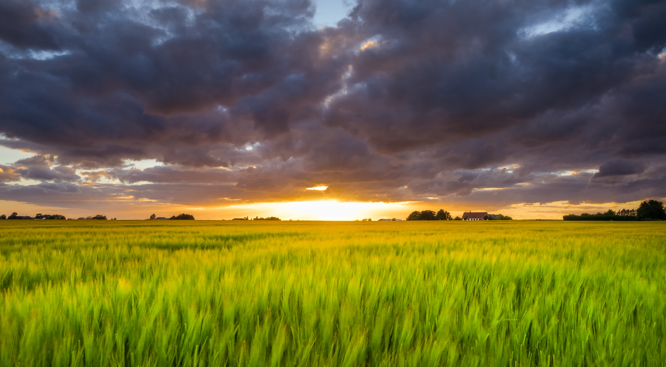
© Jacek Oleksinski, NATURE@work EEA

Slide 6
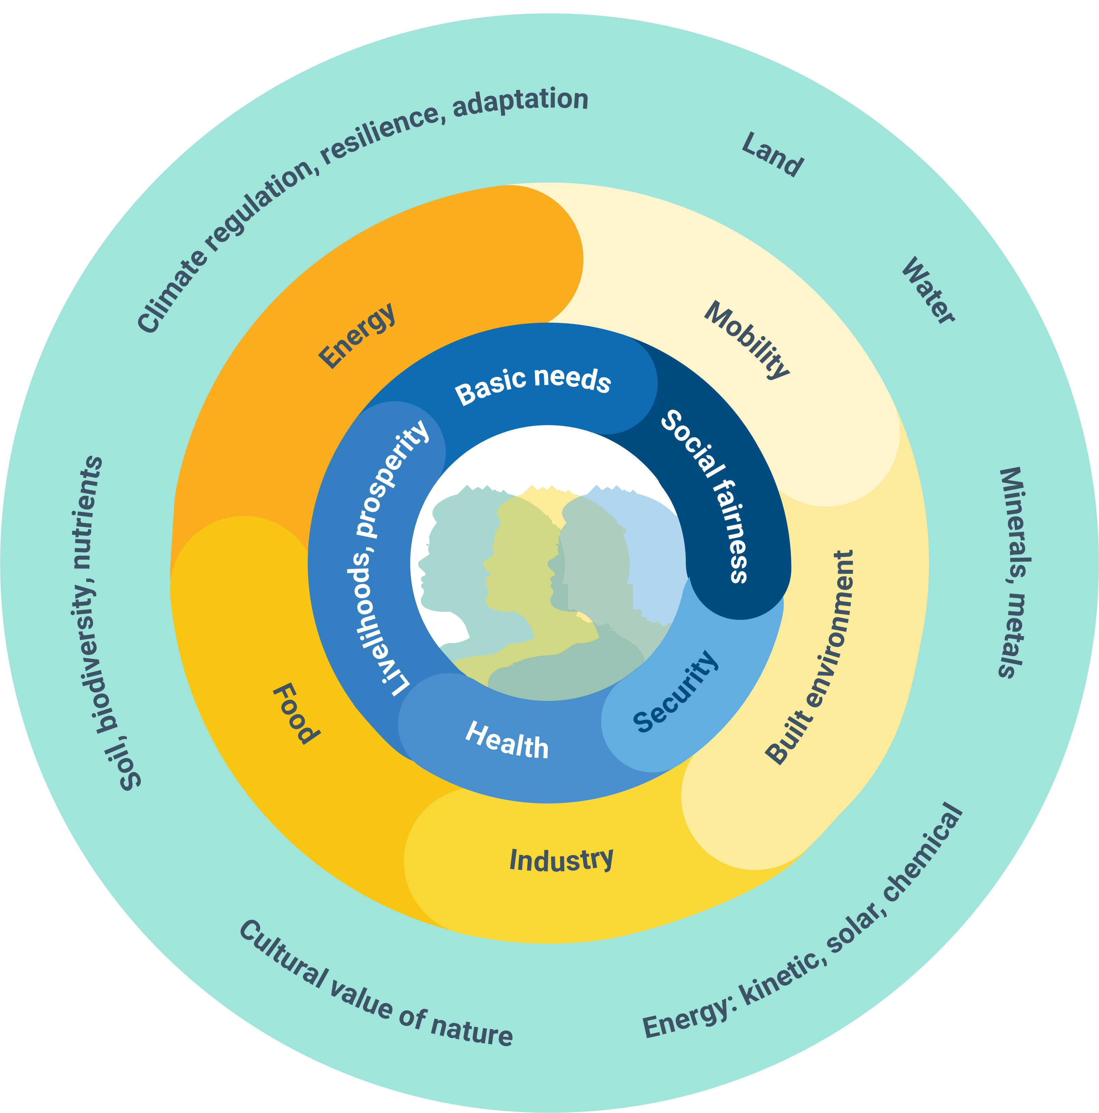
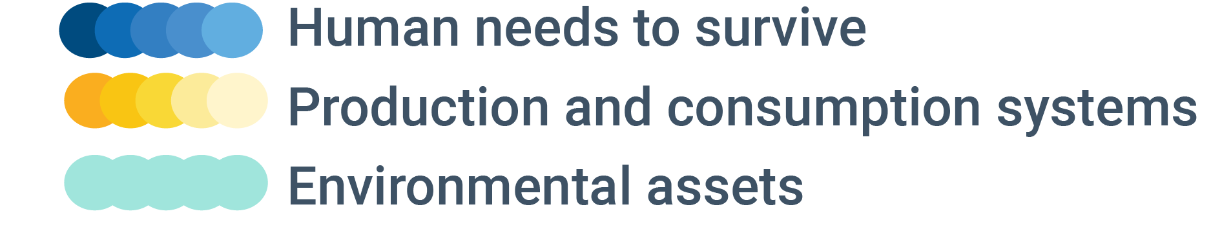
Nature: key to human health and prosperity

Slide 7
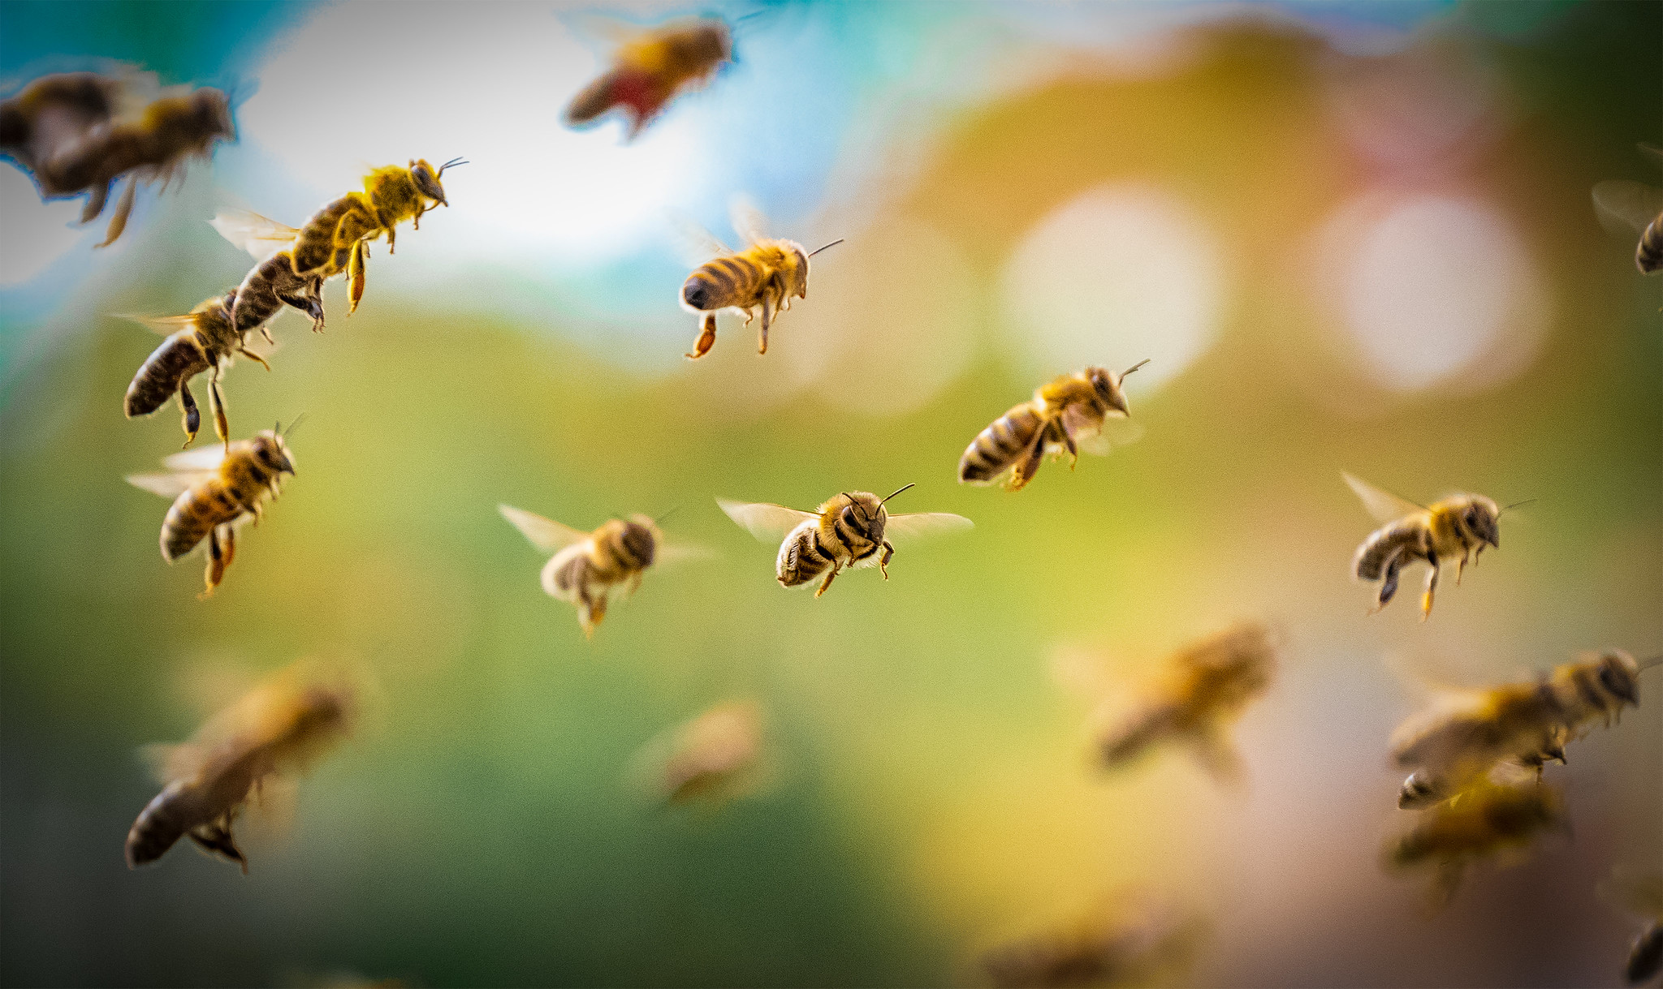

© Sebastian Škoić, REDISCOVER Nature EEA

Slide 8
Europe’s environment: biodiversity and ecosystems
Slide title: and here
© Sebastian Škoić, REDISCOVER Nature EEA
Past trends (10-15 years) | Outlook (10-15 years)
State of biodiversity
Pollution of ecosystems
Protected areas
Water and climate impacts
Ecosystems and climate impacts
Land use and land take
Soil resources

Slide 9
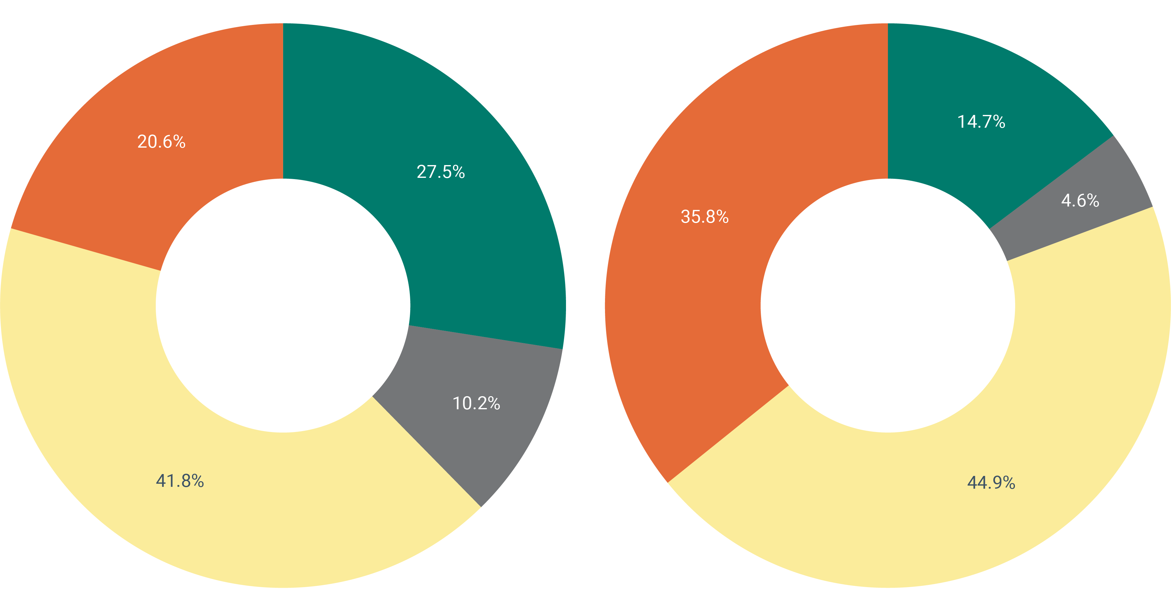
Biodiversity in decline
14.7%
20.6%
27.5%
4.6%
35.8%
10.2%
Good
Poor
Bad
Unknown
41.8%
44.9%
Conservation status of species
Conservation status of habitats
Source: EEA, 2020

Slide 10
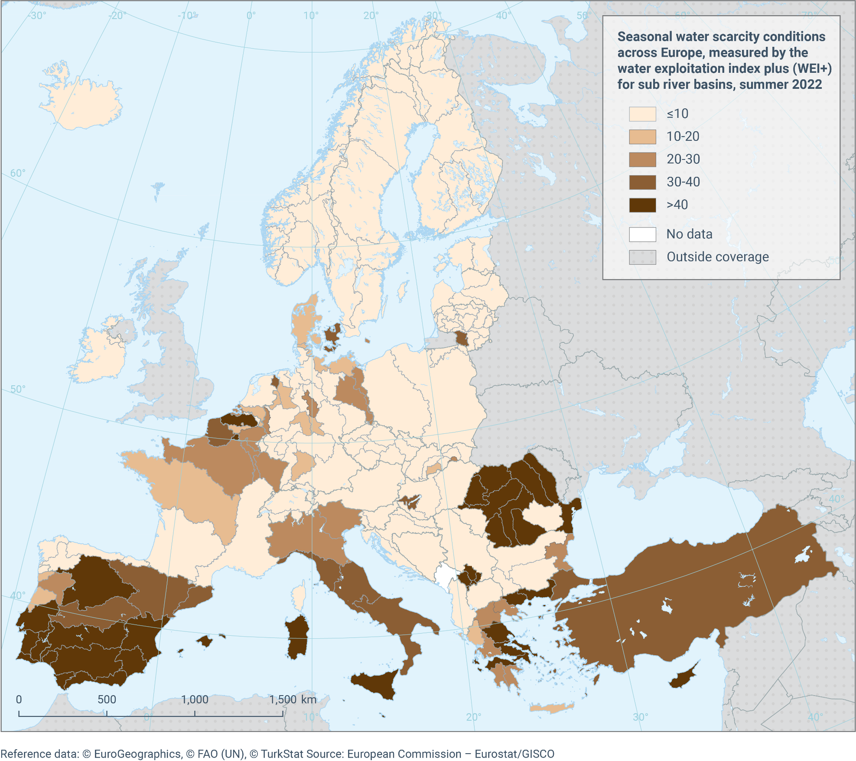
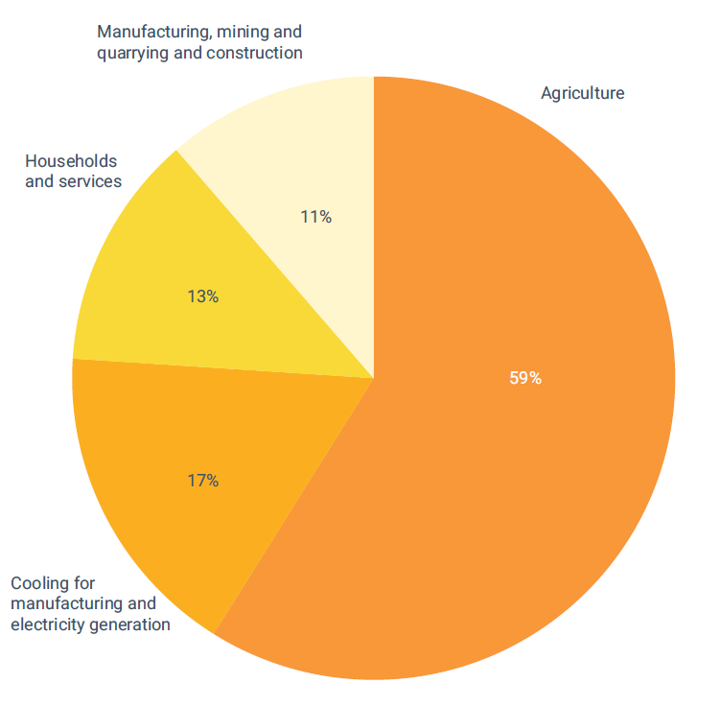
Water resources under pressure
Seasonal water scarcity
Water consumption by sector
Manufacturing, mining, quarrying, construction
11%
Household & services
13%
59%
Cooling: manufacturing & energy generation
Agriculture
17%
Source: EEA, 2024
Source: EEA, 2025

Slide 11
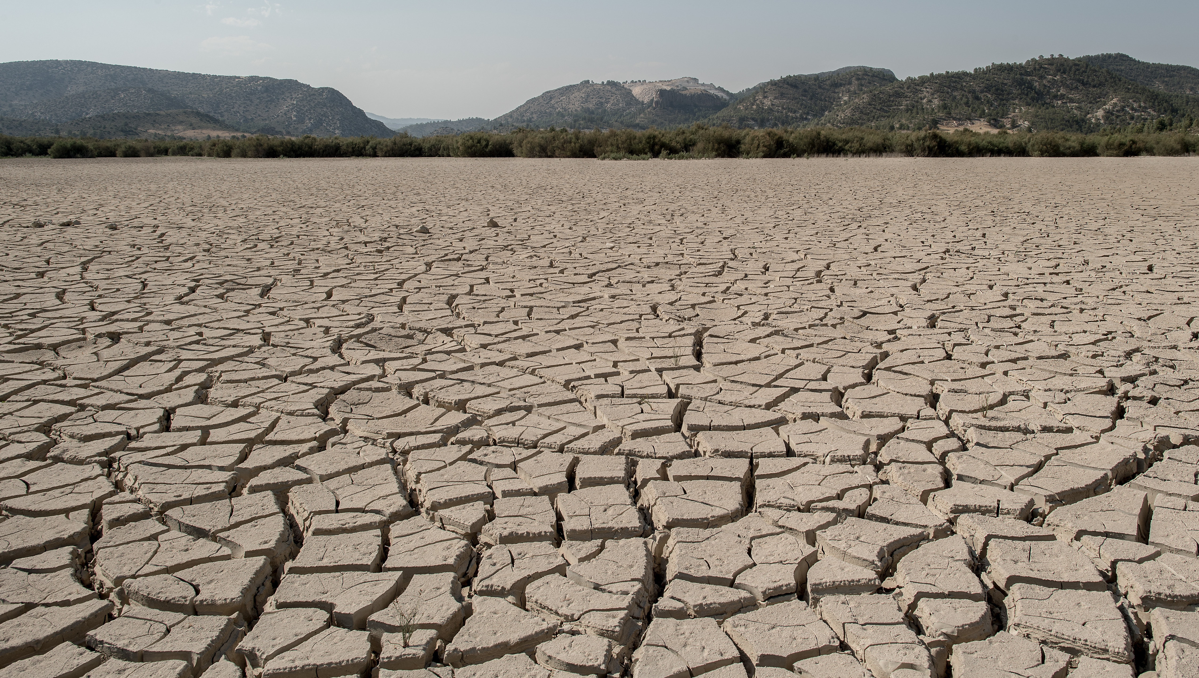
©David Ramos via Getty Images

Slide 12
Europe’s environment: climate change
Slide title: and here
Slide title: and here
©David Ramos via Getty Images
Past trends (10-15 years) | Outlook (10-15 years)
Greenhouse gas emissions
Mobility system trends
Energy system trends
CO₂ storage in forests/land
Climate risks to economy
Climate risks to society
Climate change governance

Slide 13
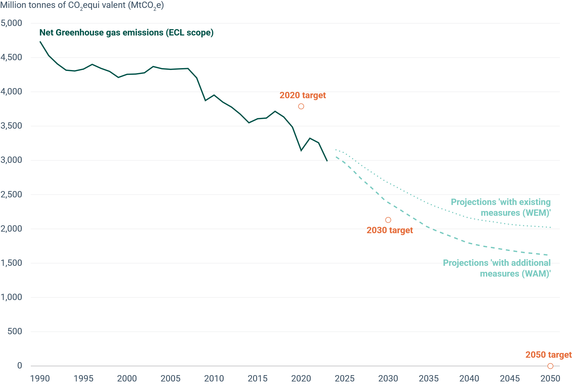
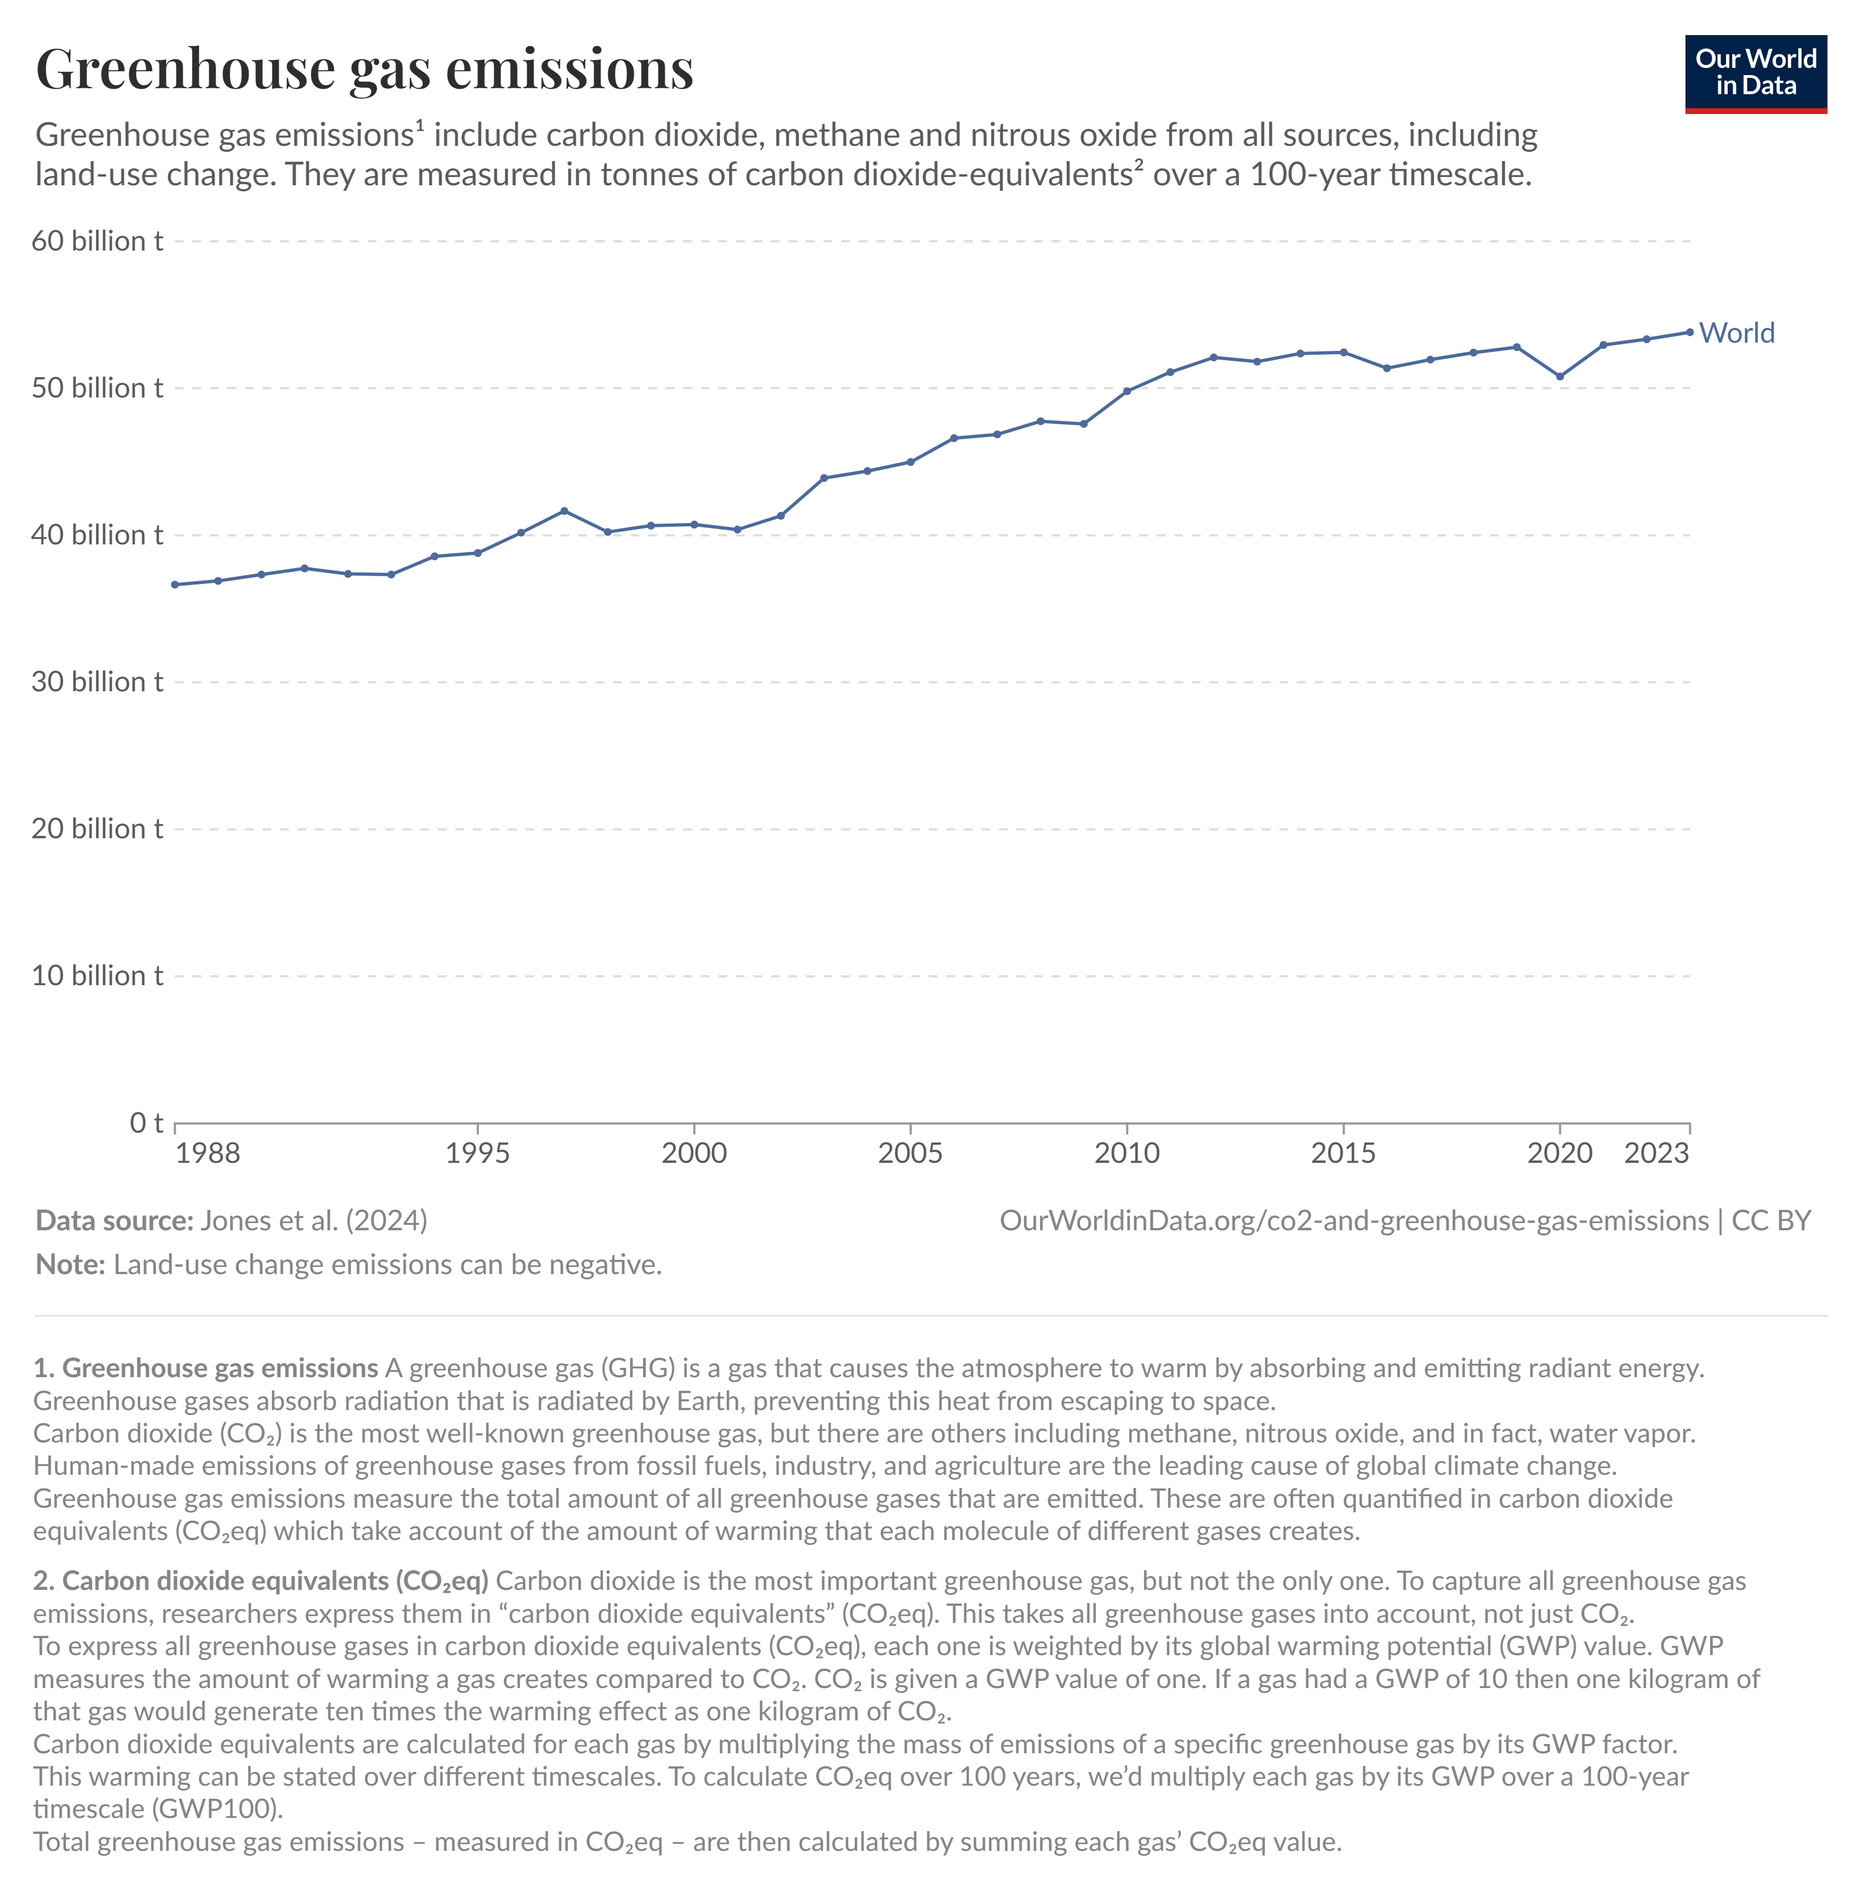
Good progress on GHG emissions in Europe, but rising globally
EU domestic GHG emissions -37% since 1990
Global GHG emissions continue to rise
Source: EEA, 2025
Source: Jones et al., 2024

Slide 14
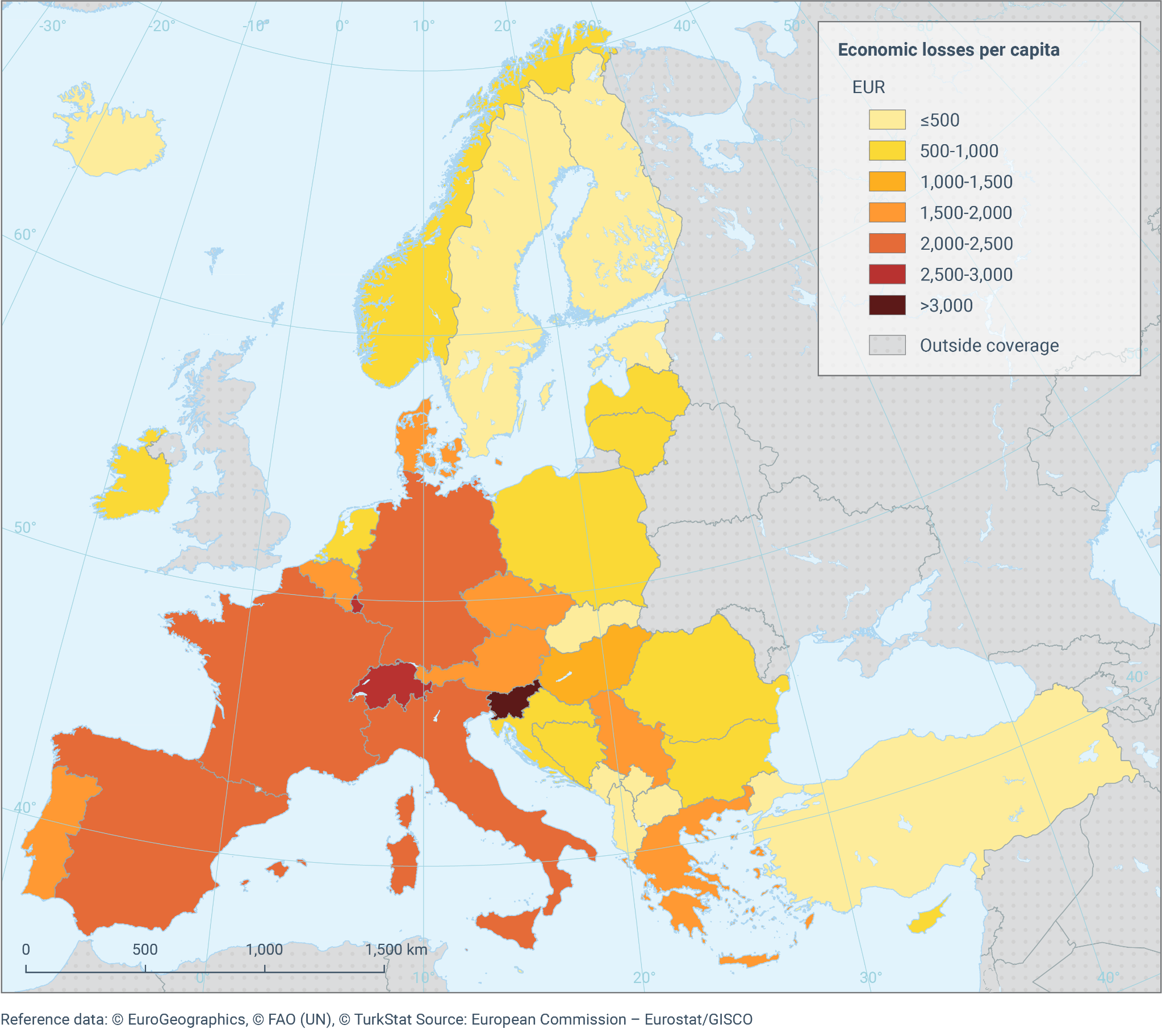
Climate change drives economic losses
Total economic losses from climate change per capita 1980-2023

Slide 15
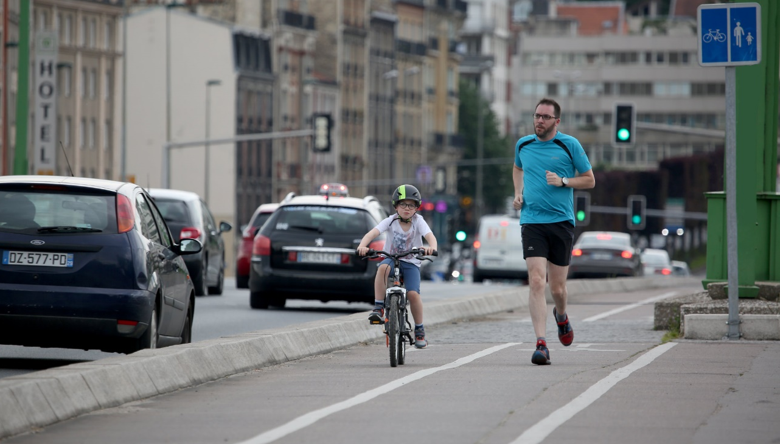
© Fan LI, My City EEA

Slide 16
Europe’s environment: environment and health
Slide title: and here
Past trends (10-15 years) | Outlook (10-15 years)
Emissions of pollutants to air
Air pollution & health
Environmental noise & health
Water pollution & health
Chemical pollution & health
Air pollution & health inequalities

Slide 17
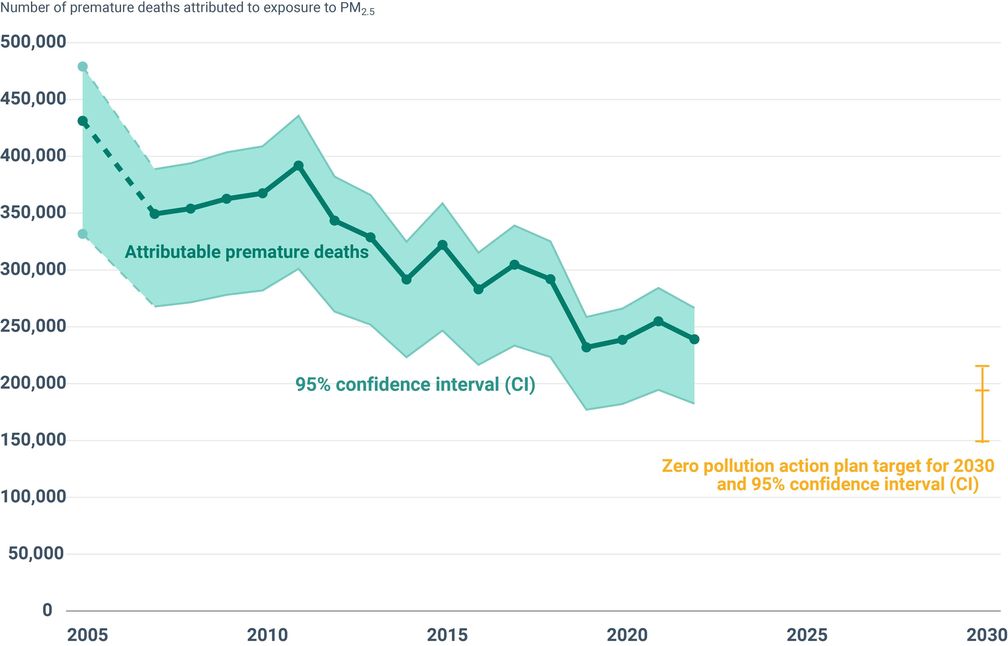
EU air quality policies are saving lives
Premature deaths attributable to exposure to fine particulate matter (PM₂.₅), EU-27, 2005-2022
Source: EEA, 2025

Slide 18
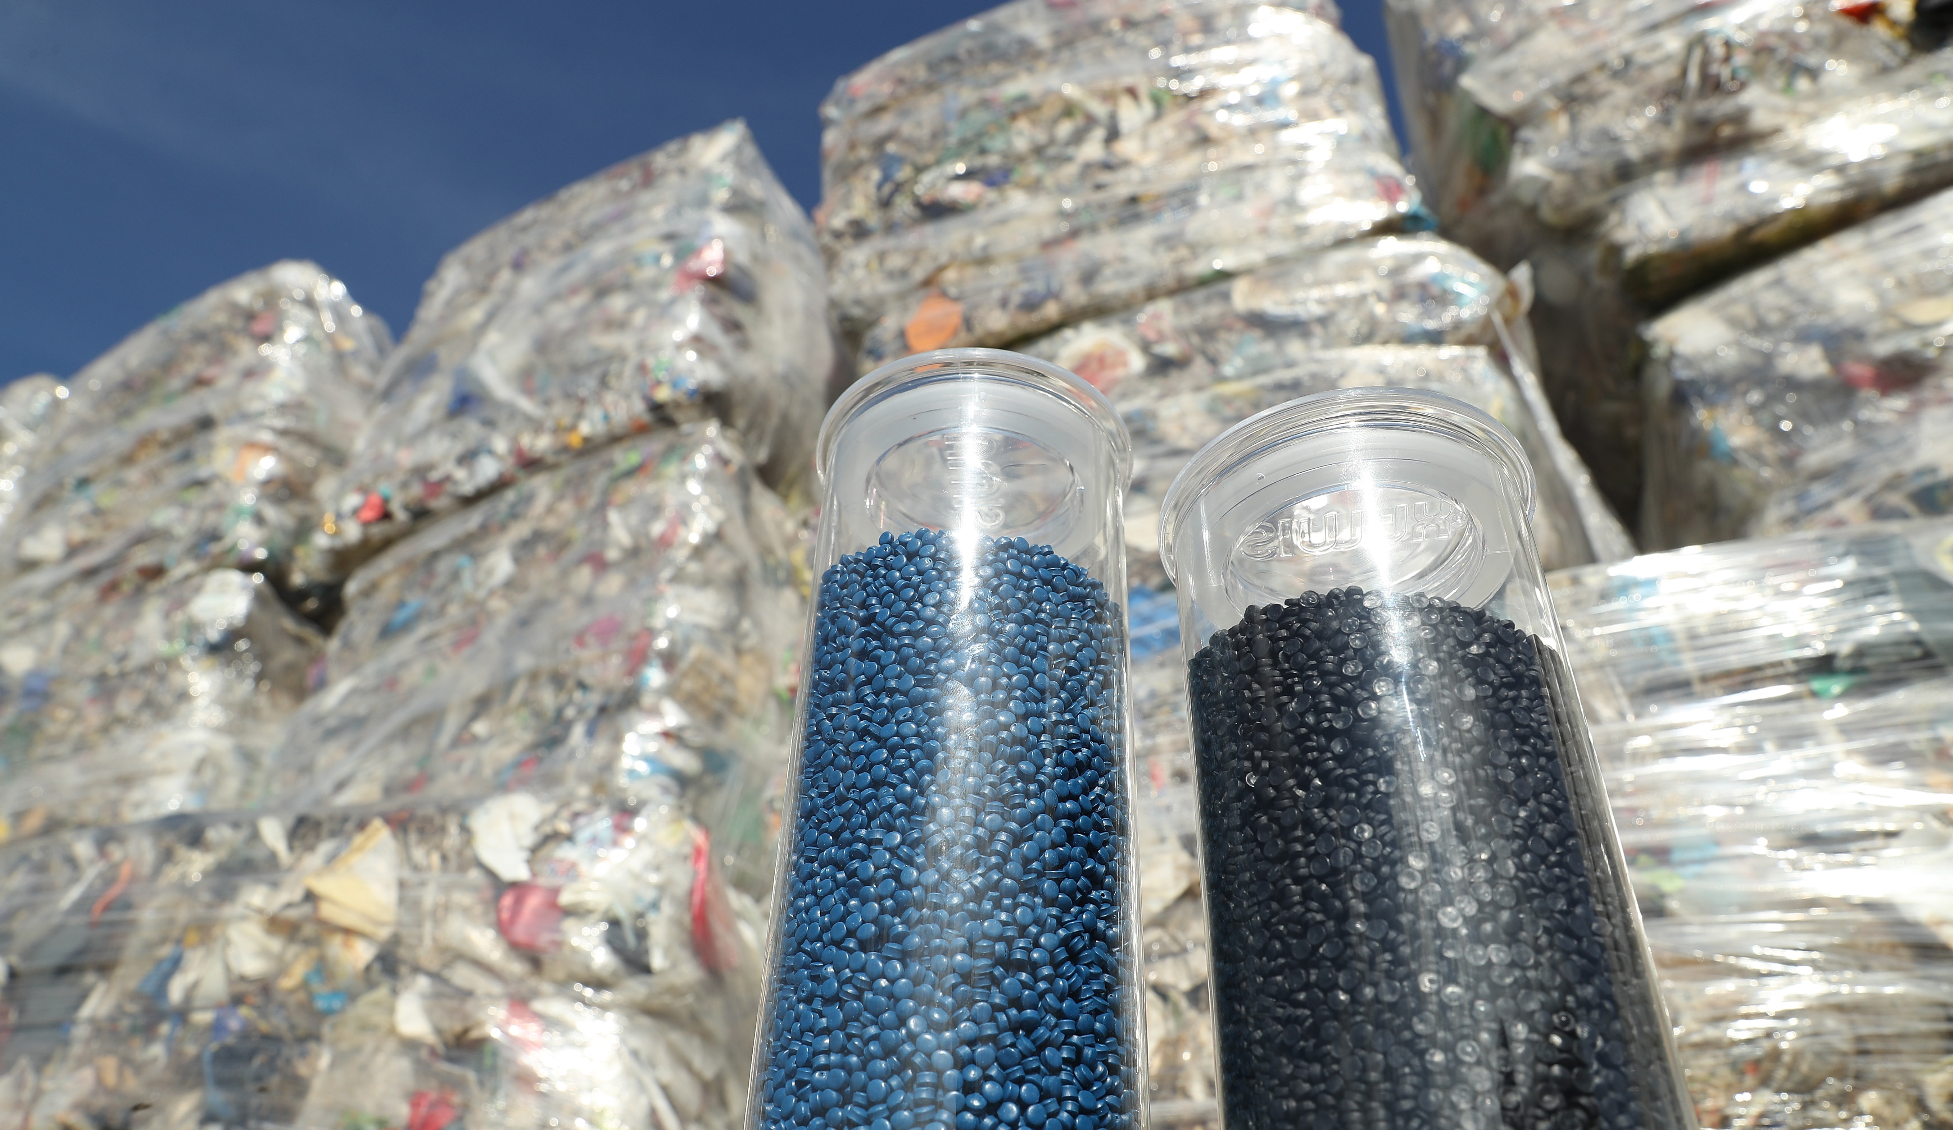
©Sean Gallup via Getty Images

Slide 19
Europe’s environment: circular economy
Slide title: and here
©Sean Gallup via Getty Images
Past trends (10-15 years) | Outlook (10-15 years)
Circular design
Waste generation
Waste recycling
Circular use of materials
Impacts from consumption

Slide 20
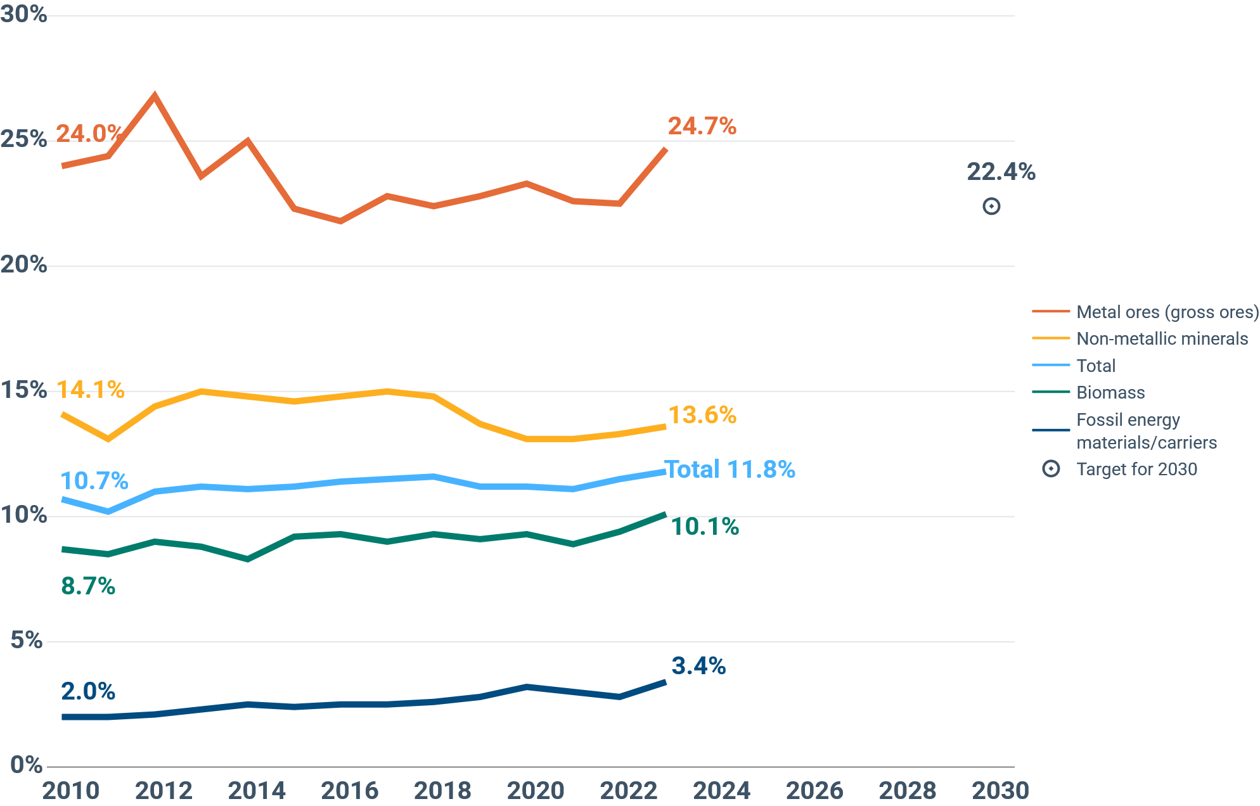
Circularity in Europe is stagnating
Trends in circular material use rates, by material
Metal ores
Non-metallic minerals
Biomass
Fossil energy materials
Source: Eurostat, 2024

Slide 21
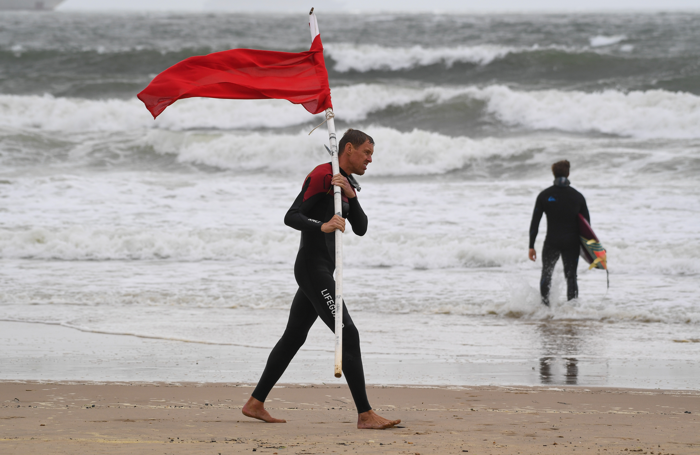

Europe’s environment: Red flags
©Finnbarr webster via Getty Images
Biodiversity and ecosystems
Ongoing biodiversity loss
Impacts of climate change on ecosystems
Soil degradation and water scarcity
Climate
Severe impacts of climate change
Falling rates of carbon sequestration
Emissions from agriculture and transport
Pollution and health
Chemicals
Water scarcity and pollution
Degradation of marine ecosystems
Circular economy
Slow progress towards circularity
Unsustainable consumption

Slide 22
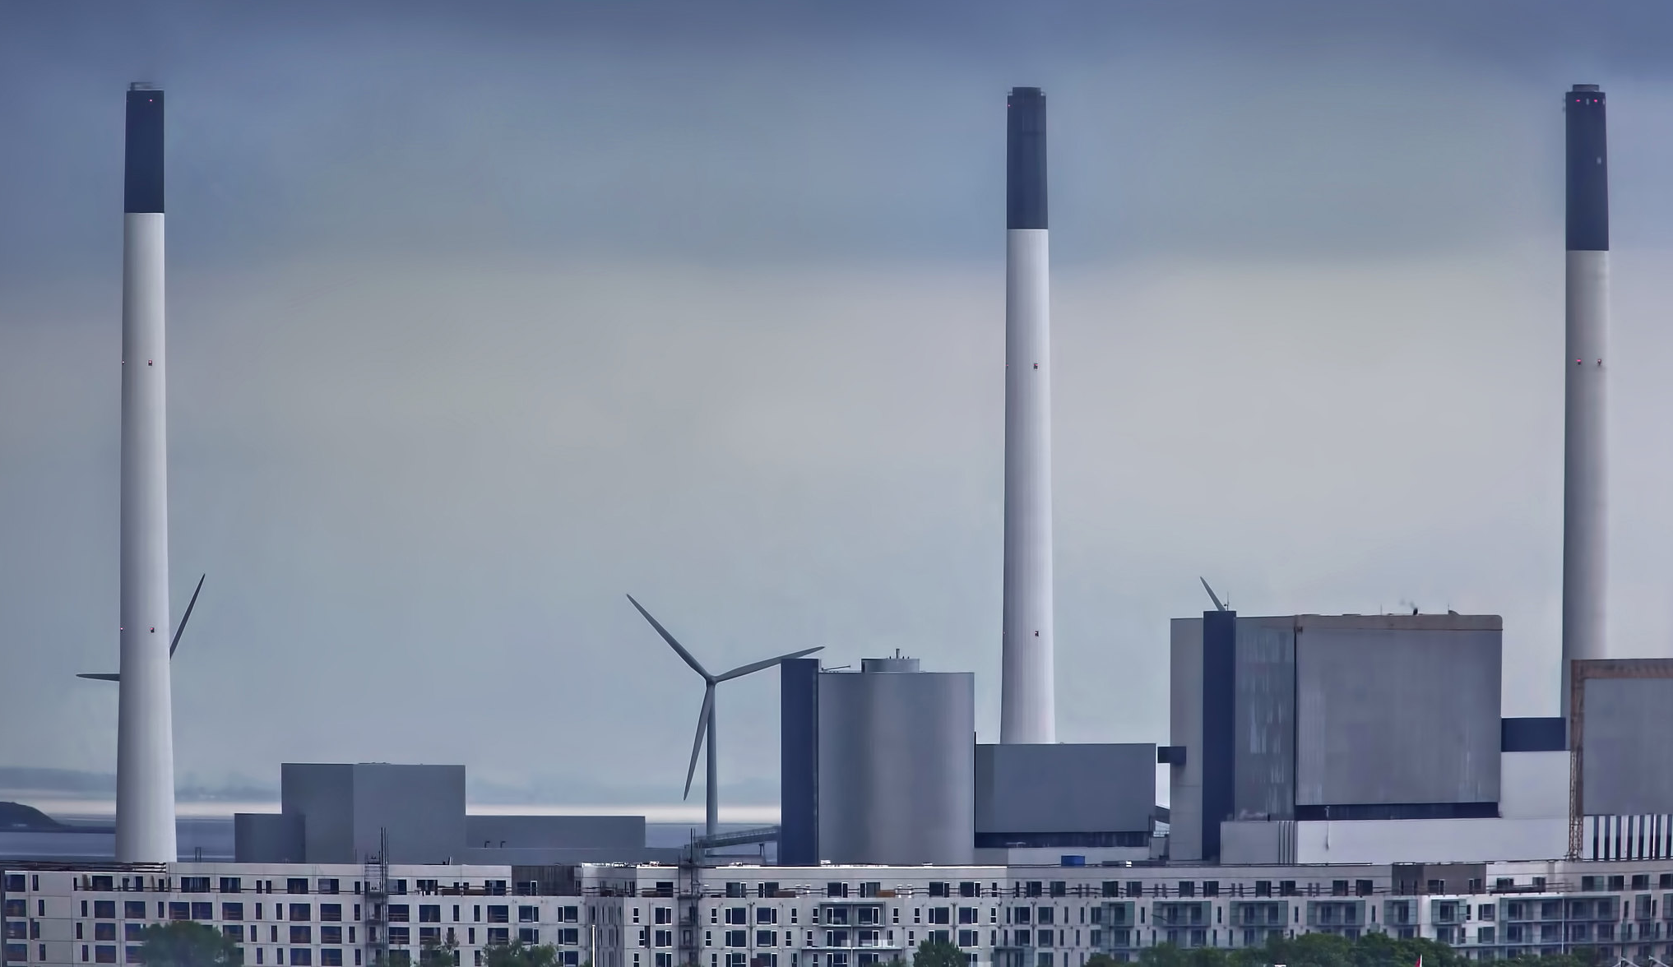
© Andrzej Bochenski, Picture2050 EEA

Slide 23
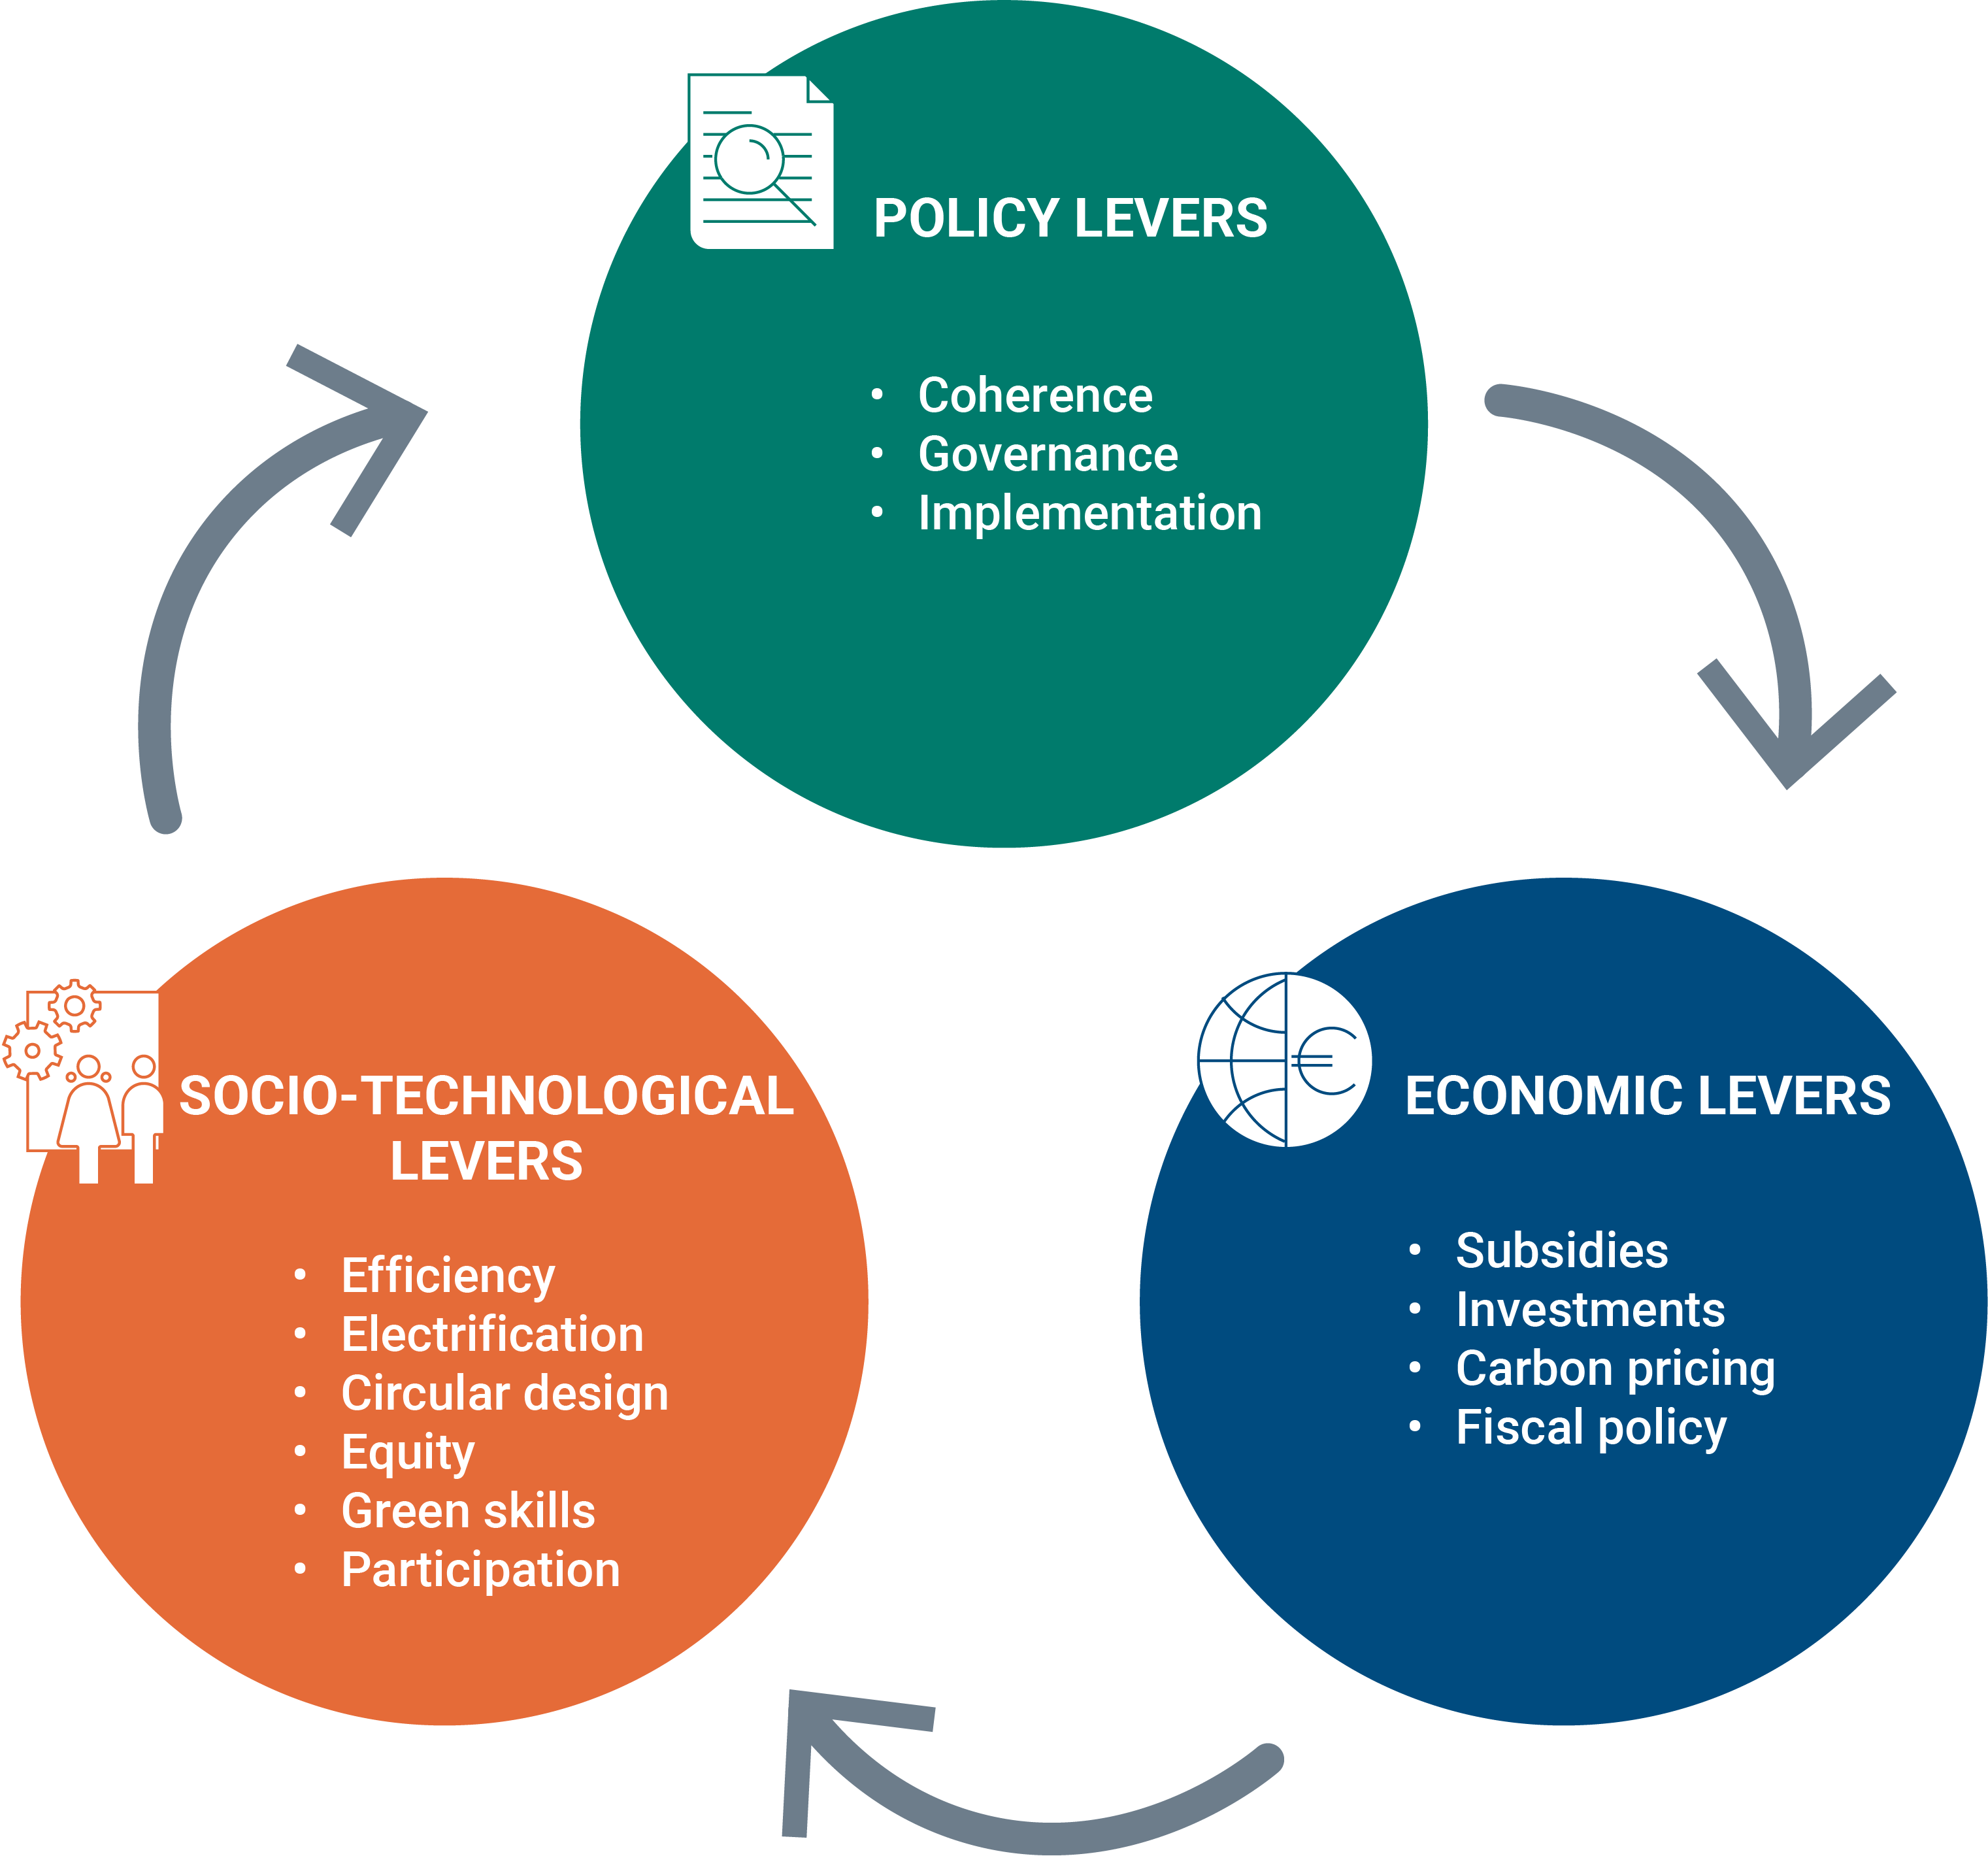
Levers of change and reasons for hope
© Andrzej Bochenski, Picture2050 EEA
© xxxxxx EEA

Slide 24
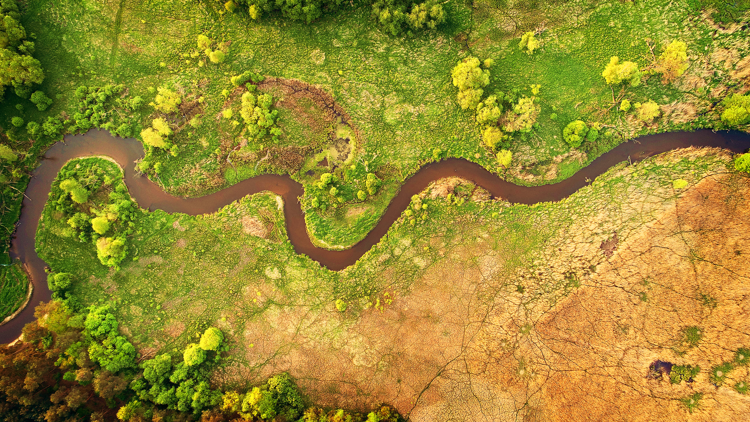
Nature for security, competitiveness, resilience and prosperity
© Piotr Krześlak, WaterPIX EEA

Slide 25
Thank you
Leena Ylä-Mononen, EEA Executive Director, 30 September 2025

